Slide 1
OOPS Concepts with java
By – Intkhab AHMED
Android Developer, gleac
Twitter - @intkhab_ahmed
GitHub - @intkhabahmed

Slide 2
What is OOP (Object oriented programming)?
Object-oriented programming (OOP) is a programming language model in which programs are organized around data, or objects, rather than functions and logic.
Examples of an object can be a human being that is described by properties like name and address.

Slide 3
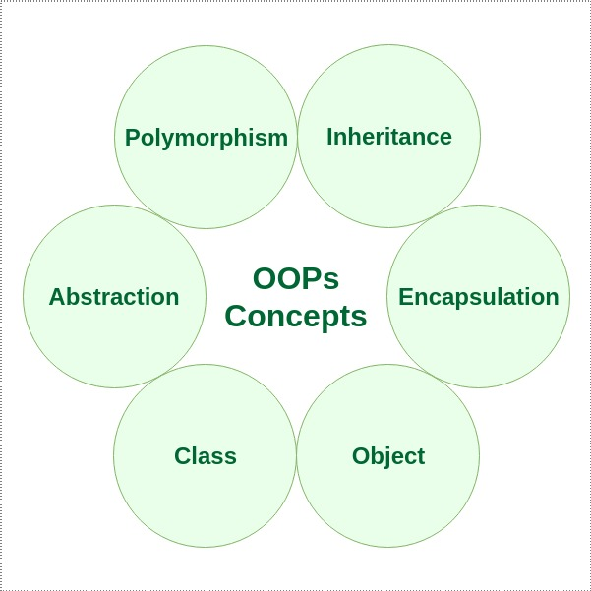

Slide 4
Class:
A class is a user defined blueprint or prototype from which objects are created. It represents the set of properties or methods that are common to all objects of one type.
Syntax: [access-modifier] class [Class Name] [extends/implements] [super class/interface] {
//Class body
}
Ex – public class Person {
String name;
int age;
}

Slide 5
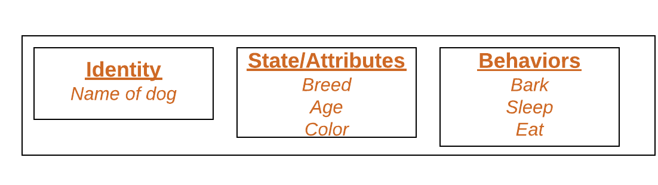
Object:
It is a basic unit of Object Oriented Programming and represents the real life entities. A typical Java program creates many objects, which as you know, interact by invoking methods. An object consists of state, behavior and identity.
Example of an object : dog

Slide 6
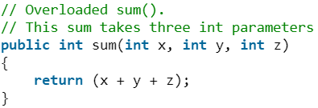
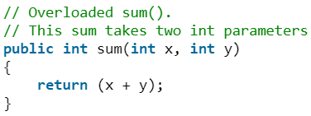
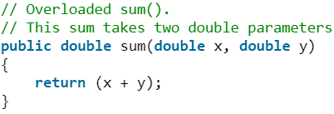
Polymorphism:
Polymorphism refers to the ability of OOPs programming languages to differentiate between entities with the same name efficiently. This is done by Java with the help of the signature and declaration of these entities.
Polymorphism in Java are mainly of 2 types:
Overloading in Java
Overriding in Java

Slide 7
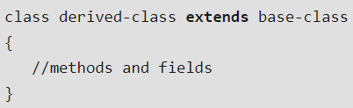
Inheritance:
Inheritance is an important pillar of OOP(Object Oriented Programming). It is the mechanism in java by which one class is allow to inherit the features(fields and methods) of another class.
The keyword used for inheritance is extends.
Syntax:

Slide 8
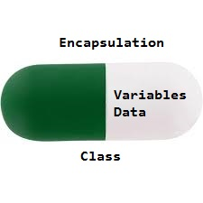
Encapsulation:
Encapsulation is defined as the wrapping up of data under a single unit. It is the mechanism that binds together code and the data it manipulates.
Encapsulation can be achieved by: Declaring all the variables in the class as private and writing public methods in the class to set and get the values of variables.

Slide 9
Abstraction:
Data Abstraction is the property by virtue of which only the essential details are displayed to the user.
The trivial or the non-essentials units are not displayed to the user. Ex: A car is viewed as a car rather than its individual components.
In java, abstraction is achieved by interfaces and abstract classes. We can achieve 100% abstraction using interfaces.

Slide 10
Exceptions - Handling error cases in code blocks ArrayList - Dynamically sized array storage ArrayList<integer> list = new ArrayList<integer>(); list.add(5); list.get(0); HashMap – key/value storage map Map<String, Integer> ratingMap = new HashMap<string, Integer>(); ratingMap.put(“Dark Knight", 5); ratingMap.put(“Pirahna 3D", 1);

Slide 11
Multithreading in Java
Multithreading is a Java feature that allows concurrent execution of two or more parts of a program for maximum utilization of CPU. Each part of such program is called a thread. So, threads are light-weight processes within a process.
Threads can be created by using two mechanisms :
1. Extending the Thread class 2. Implementing the Runnable Interface

Slide 12
Thread creation by extending the Thread class
We create a class that extends the java.lang.Thread class.
This class overrides the run() method available in the Thread class.
A thread begins its life inside run() method.
We create an object of our new class and call start() method to start the execution of a thread.
Start() invokes the run() method on the Thread object.

Slide 13
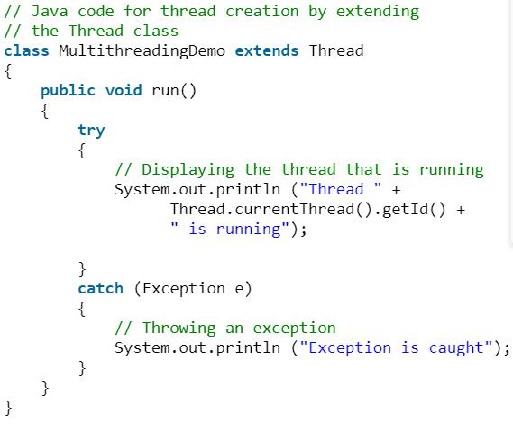
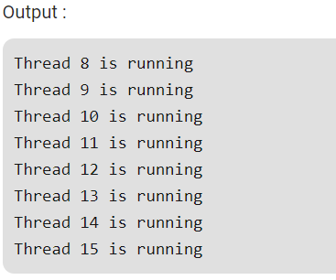
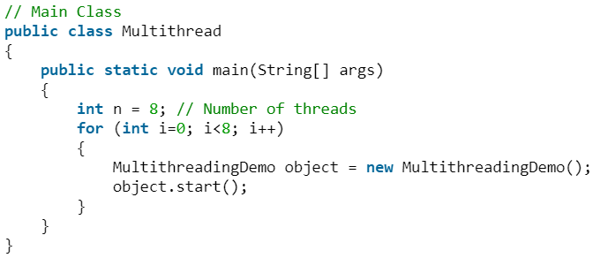

Slide 14
Thread creation by implementing the Runnable Interface
We create a new class which implements java.lang.Runnable interface and override run() method.
Then we instantiate a Thread object and call start() method on this object.

Slide 15
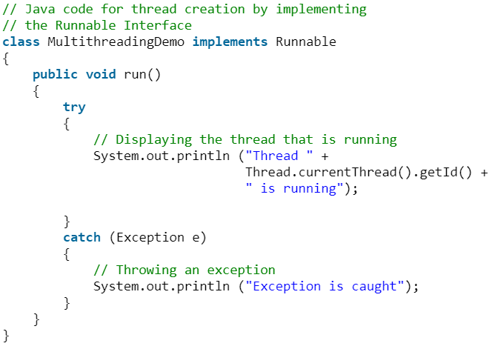
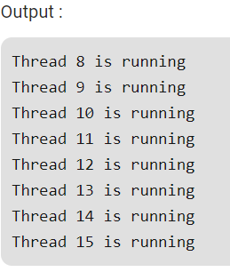
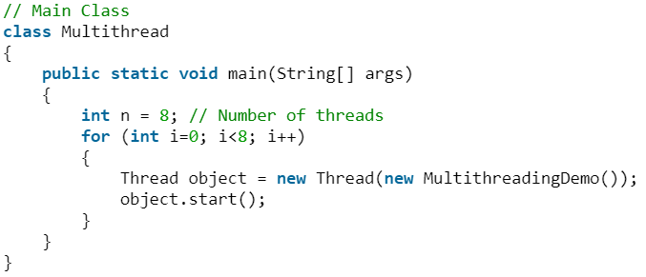

Slide 16
Thread Class vs Runnable Interface
If we extend the Thread class, our class cannot extend any other class because Java doesn’t support multiple inheritance. But, if we implement the Runnable interface, our class can still extend other base classes.
We can achieve basic functionality of a thread by extending Thread class because it provides some inbuilt methods like yield(), interrupt() etc. that are not available in Runnable interface.

